Slide 1
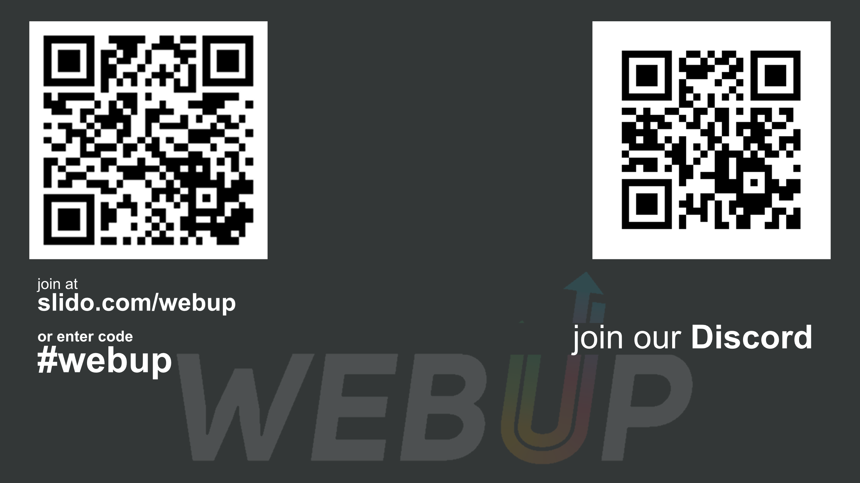

8 vývojárskych nástrojov, ktoré možno nepoznáte a mali by ste ich vyskúšať
Martin Šustek
Engineering Chapter Lead
linkedin.com/in/martin-sustek

Slide 2


Slide 3
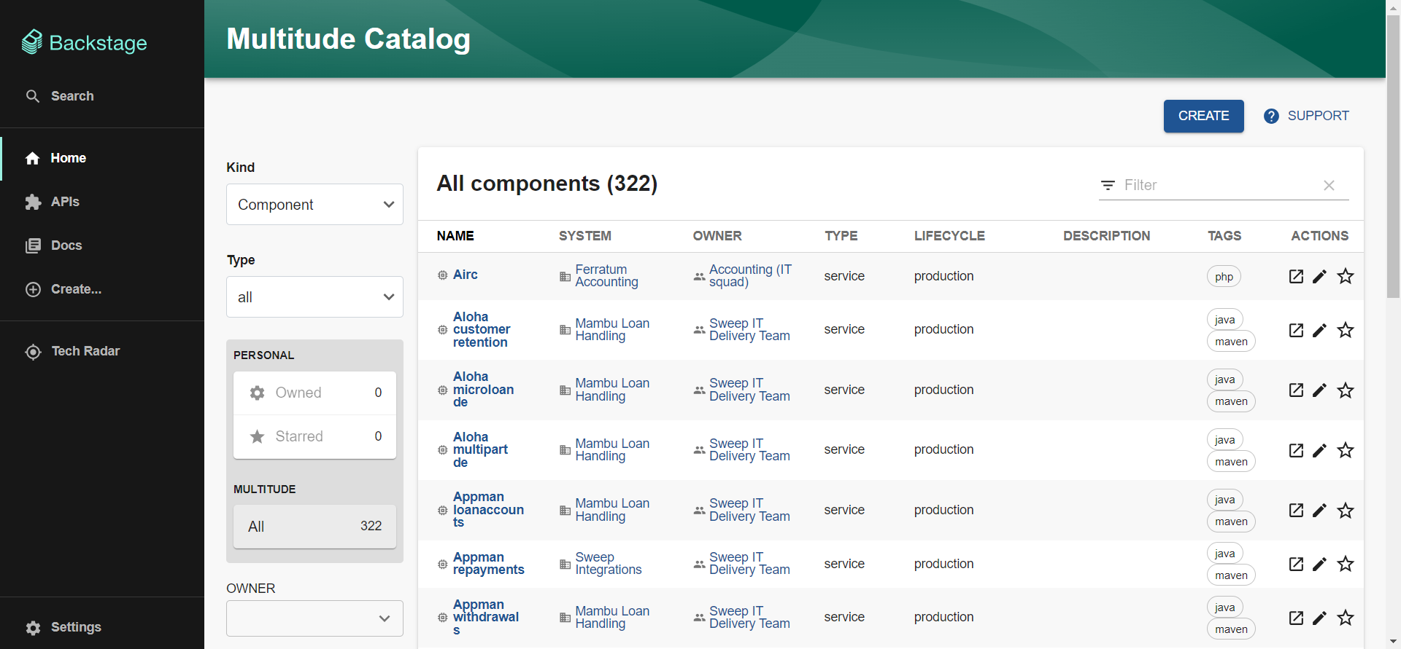

Slide 4
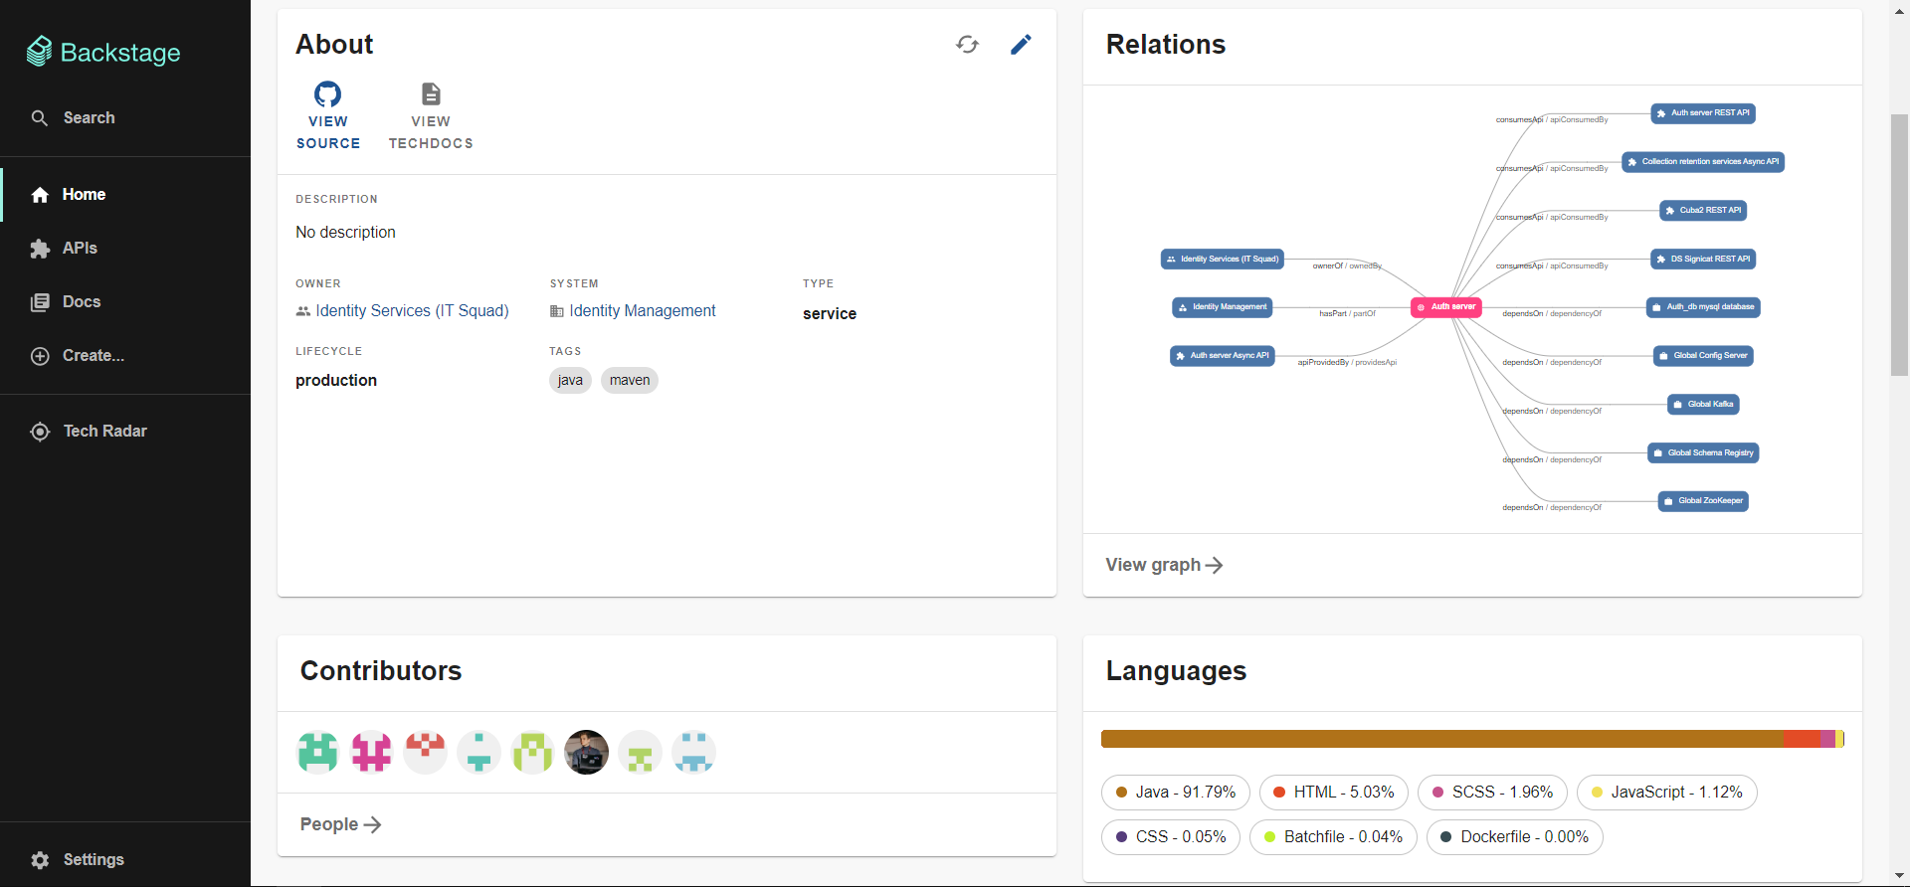

Slide 5

Feature switching & A/B testing

Slide 6
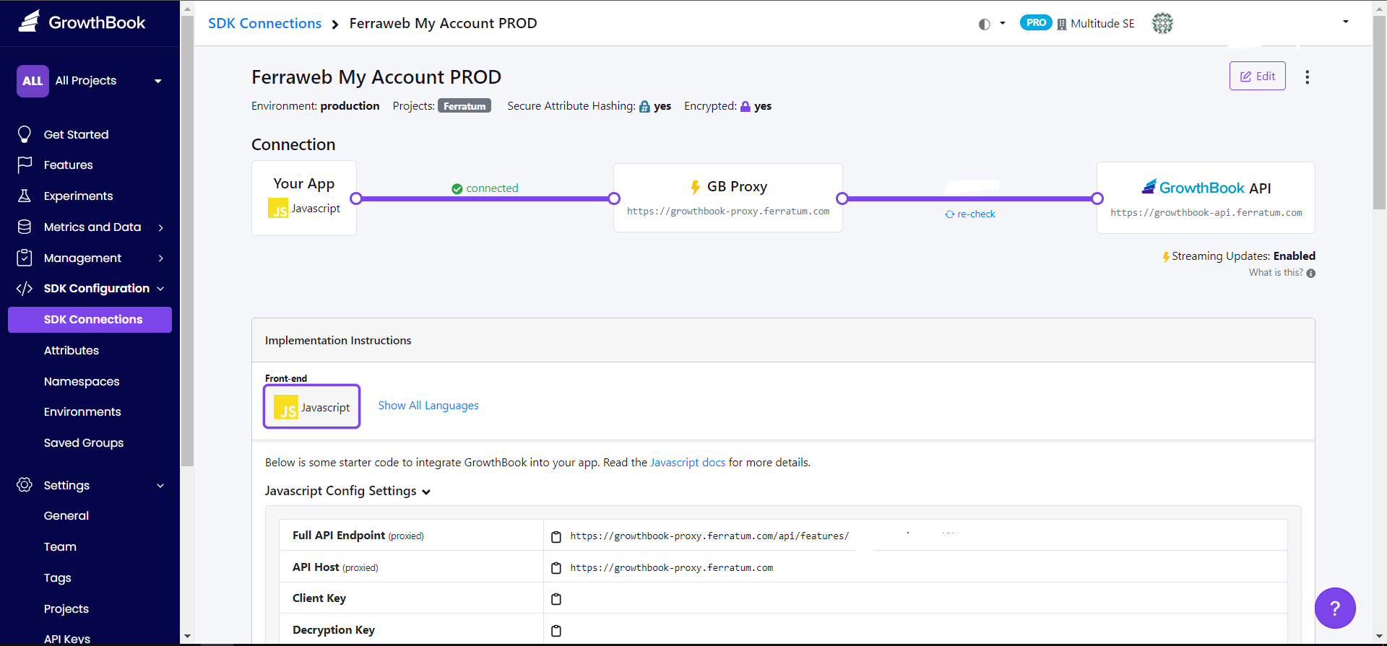

Slide 7
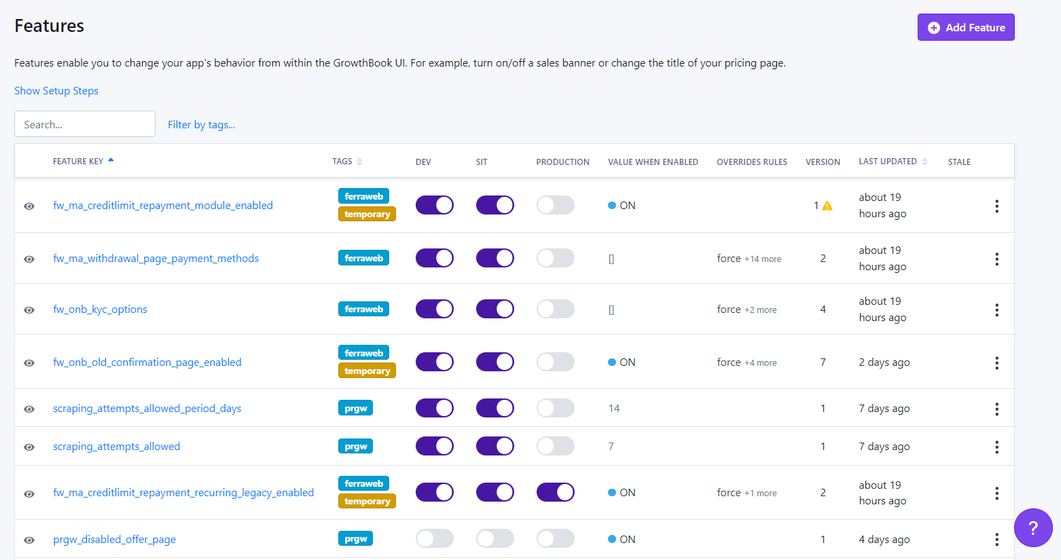

Slide 8
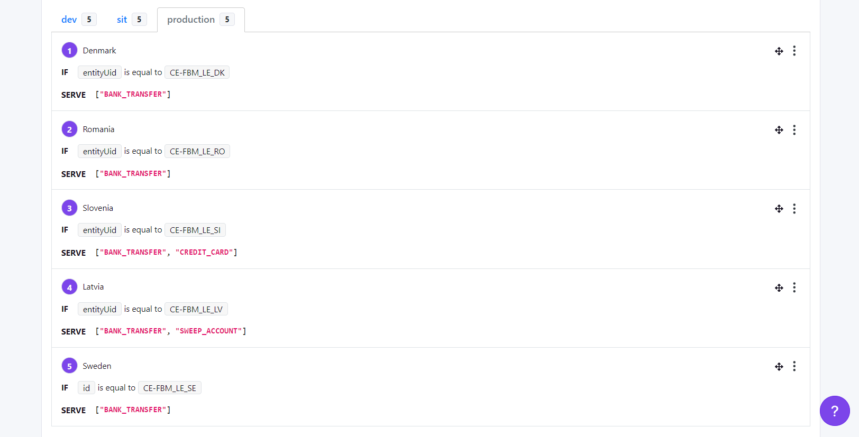

Slide 9
Dependency management

Slide 10
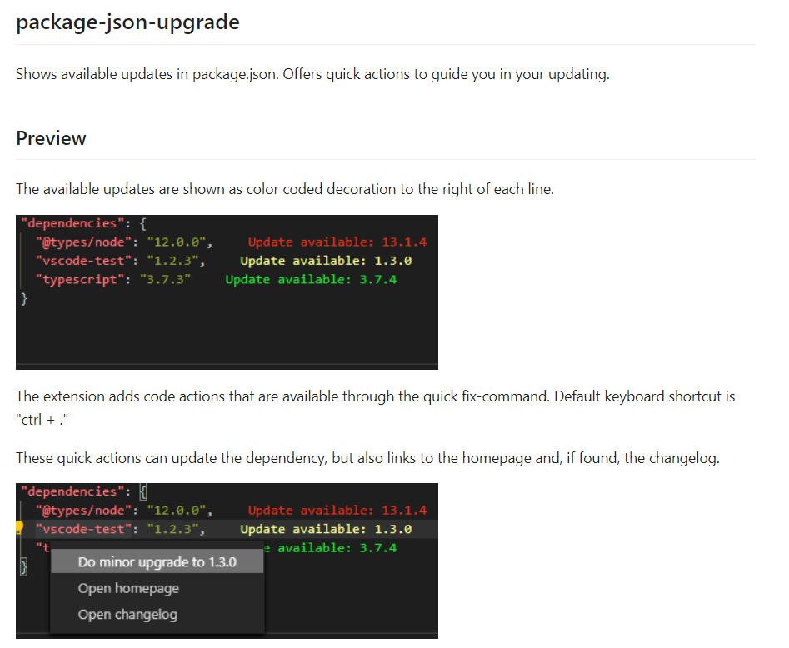

Slide 11
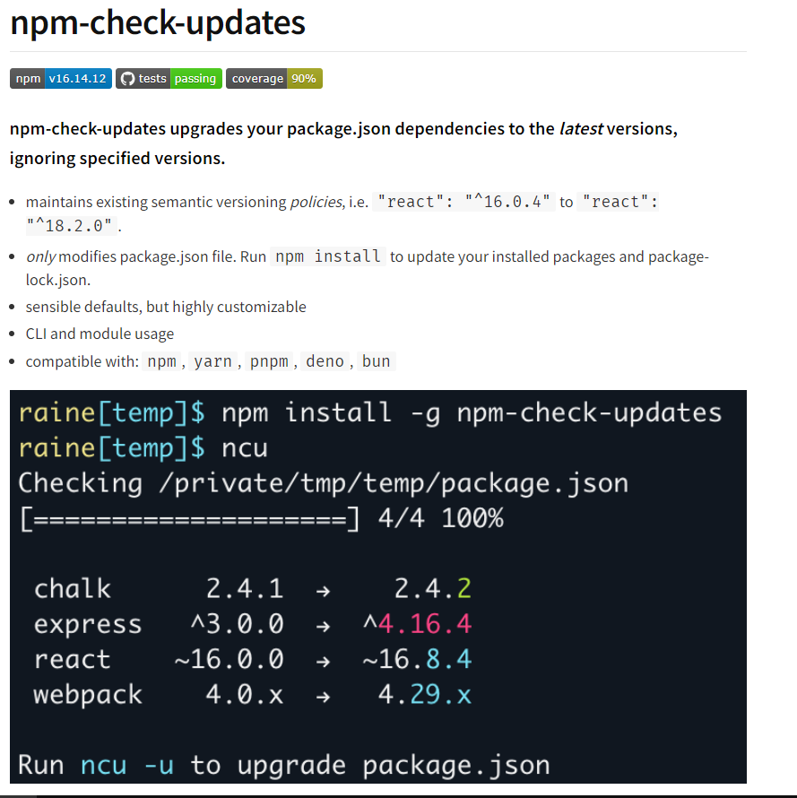

Slide 12
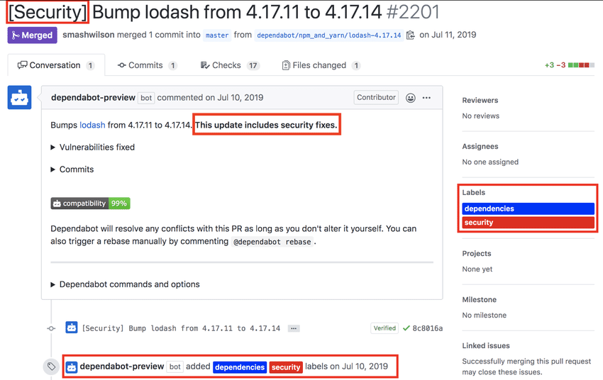
Dependabot

Slide 13
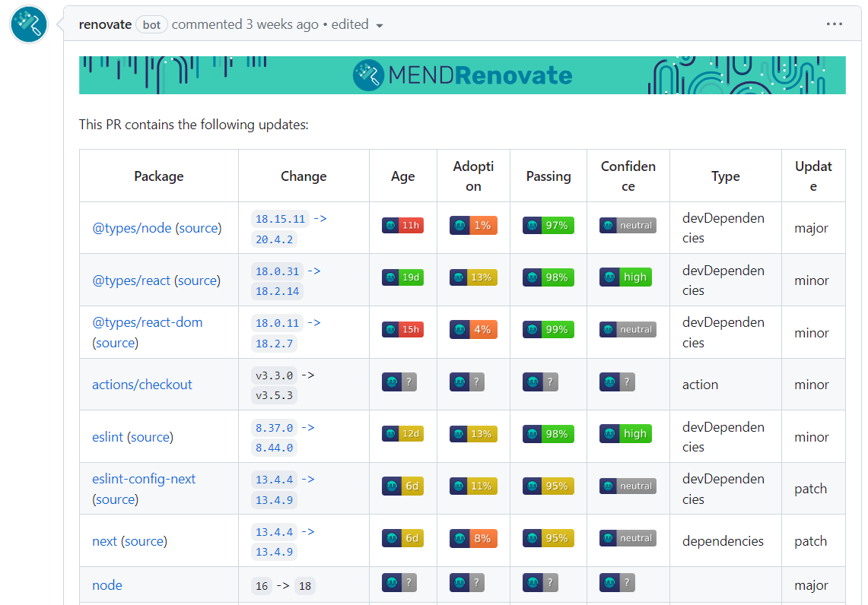
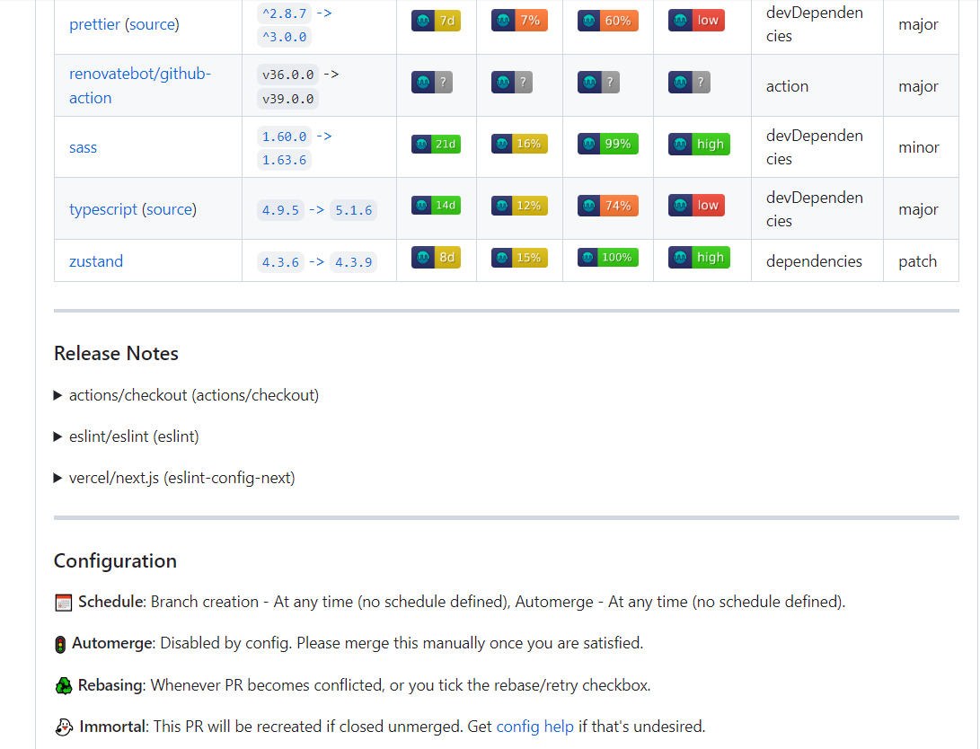
Renovate

Slide 14
Server Sent Events

Slide 15
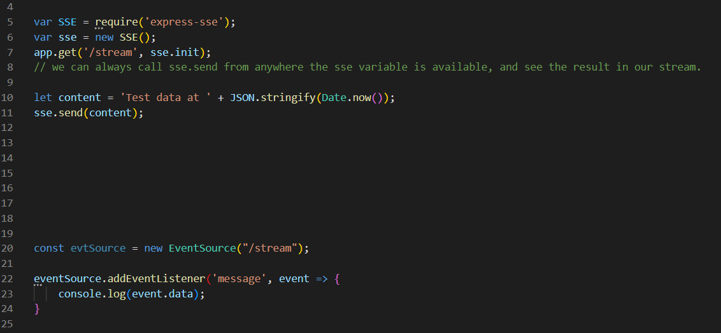
Native implementation
UTF-8 messages only
Maximum of 6 connections per browser
Mono-directional (server -> client)

Slide 16
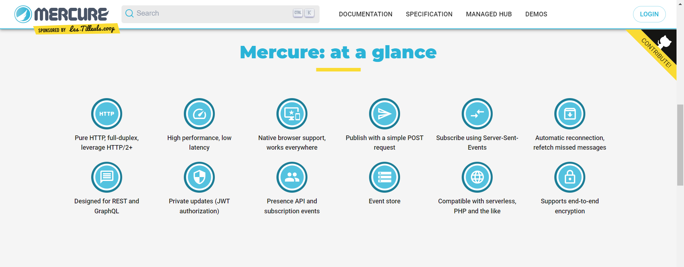
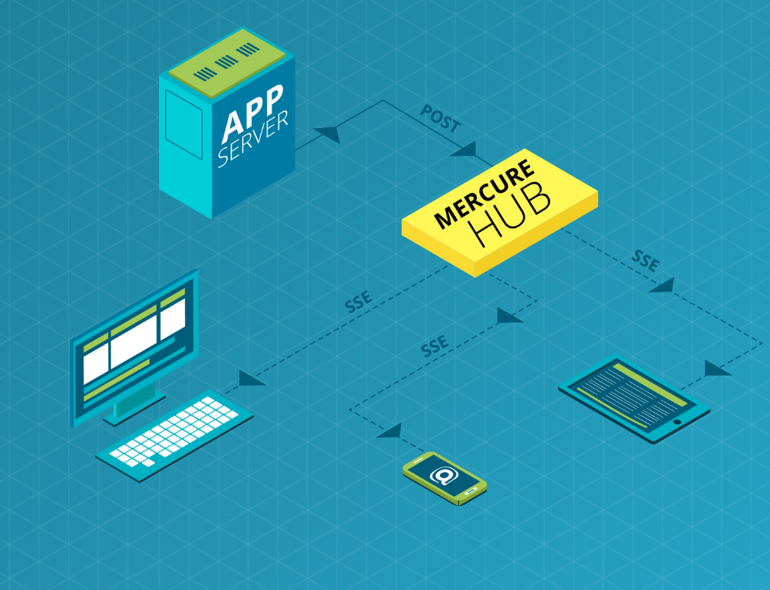

Slide 17
Just

Slide 18
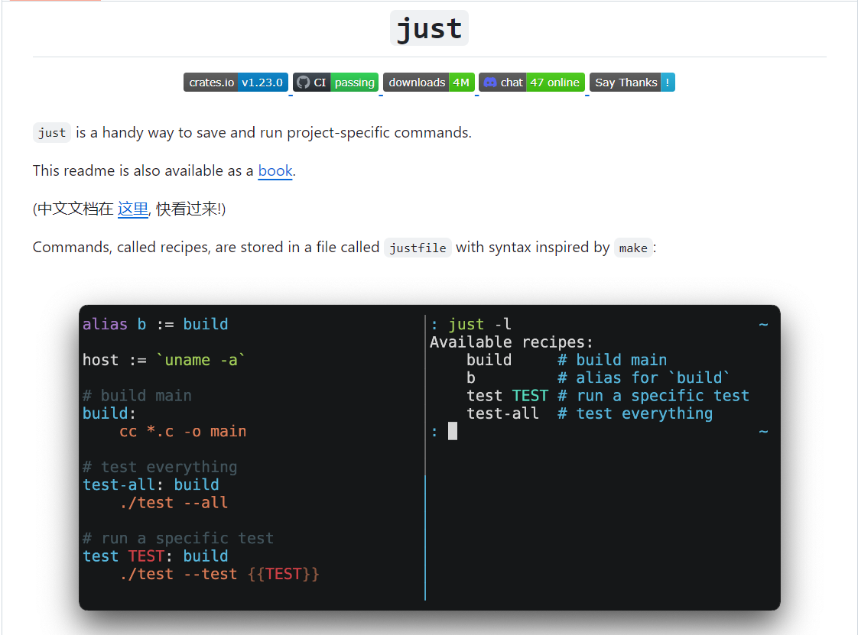

Slide 19
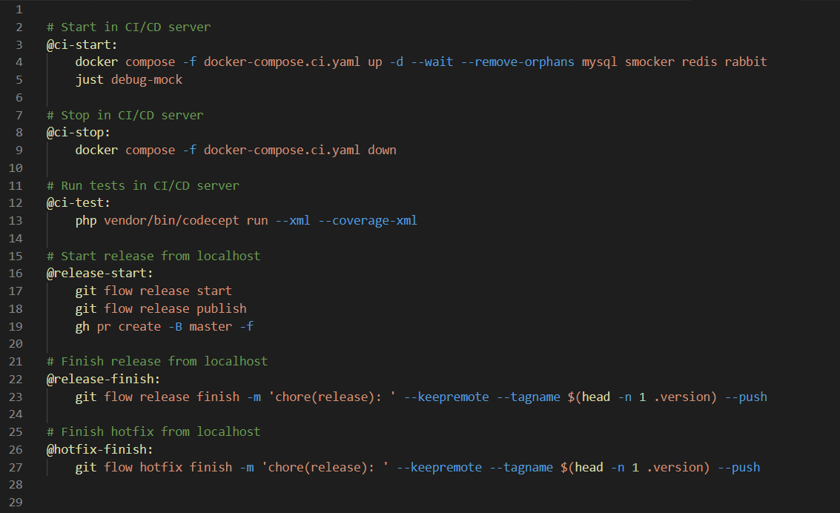

Slide 20

Plant UML

Slide 21
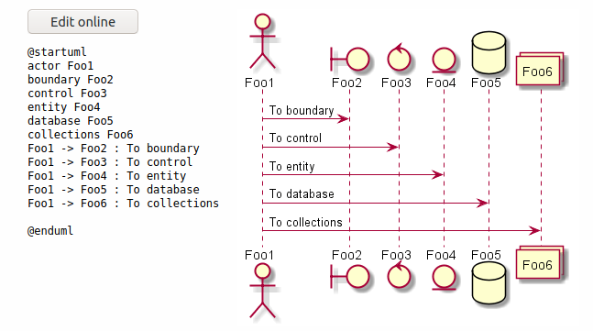

Slide 22
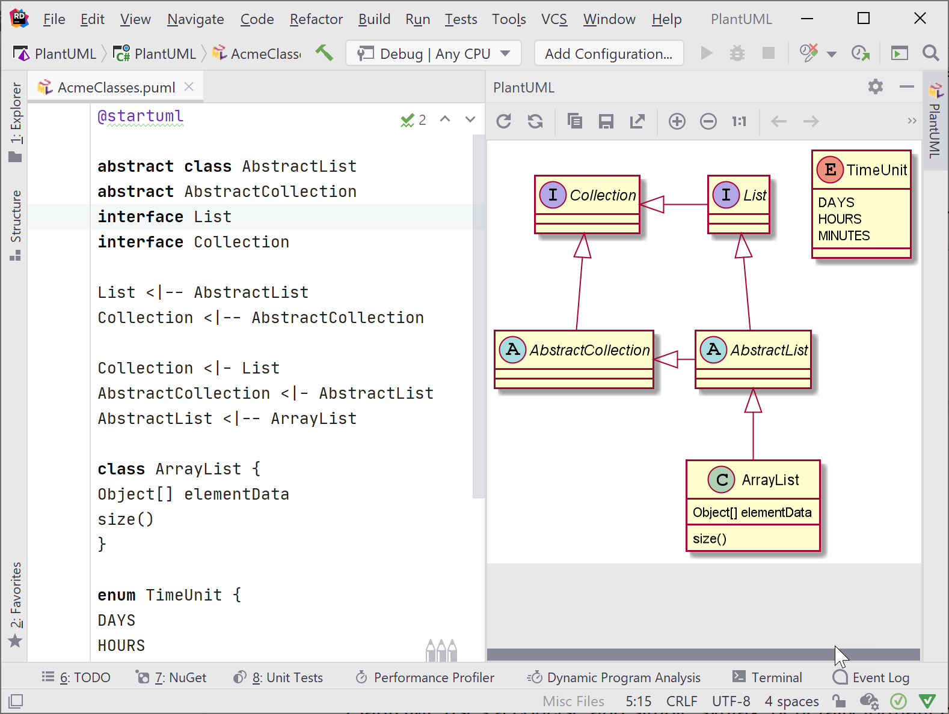

Slide 23
Mockovanie Javascript aplikácií

Slide 24
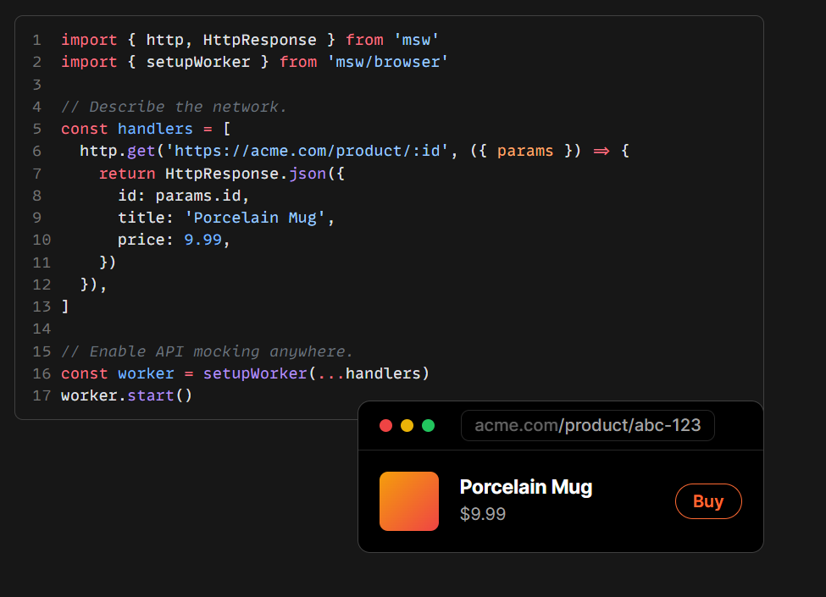


Slide 25
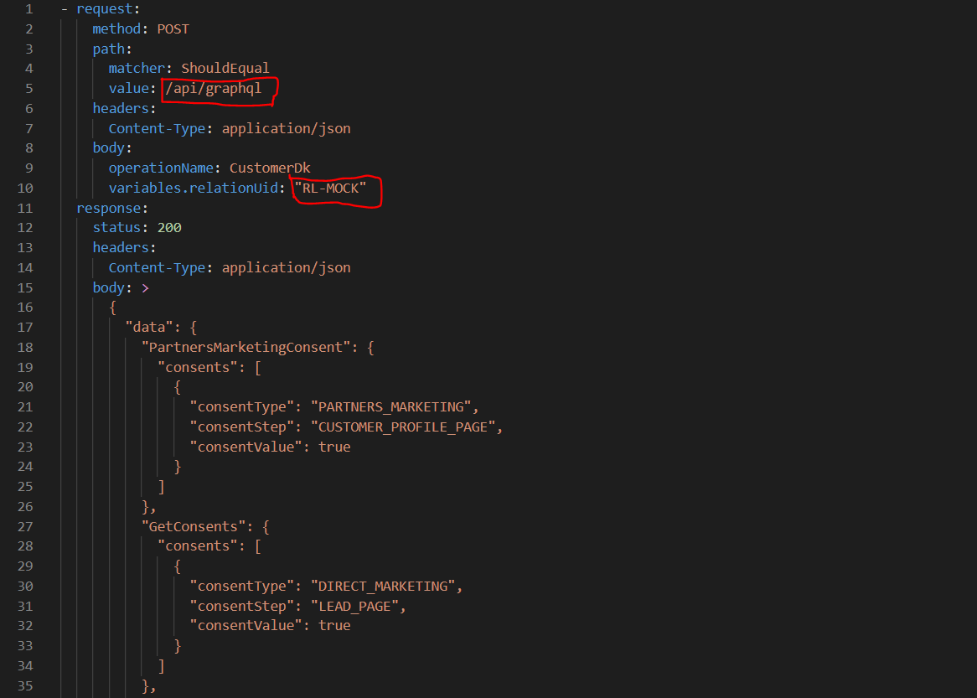


Slide 26
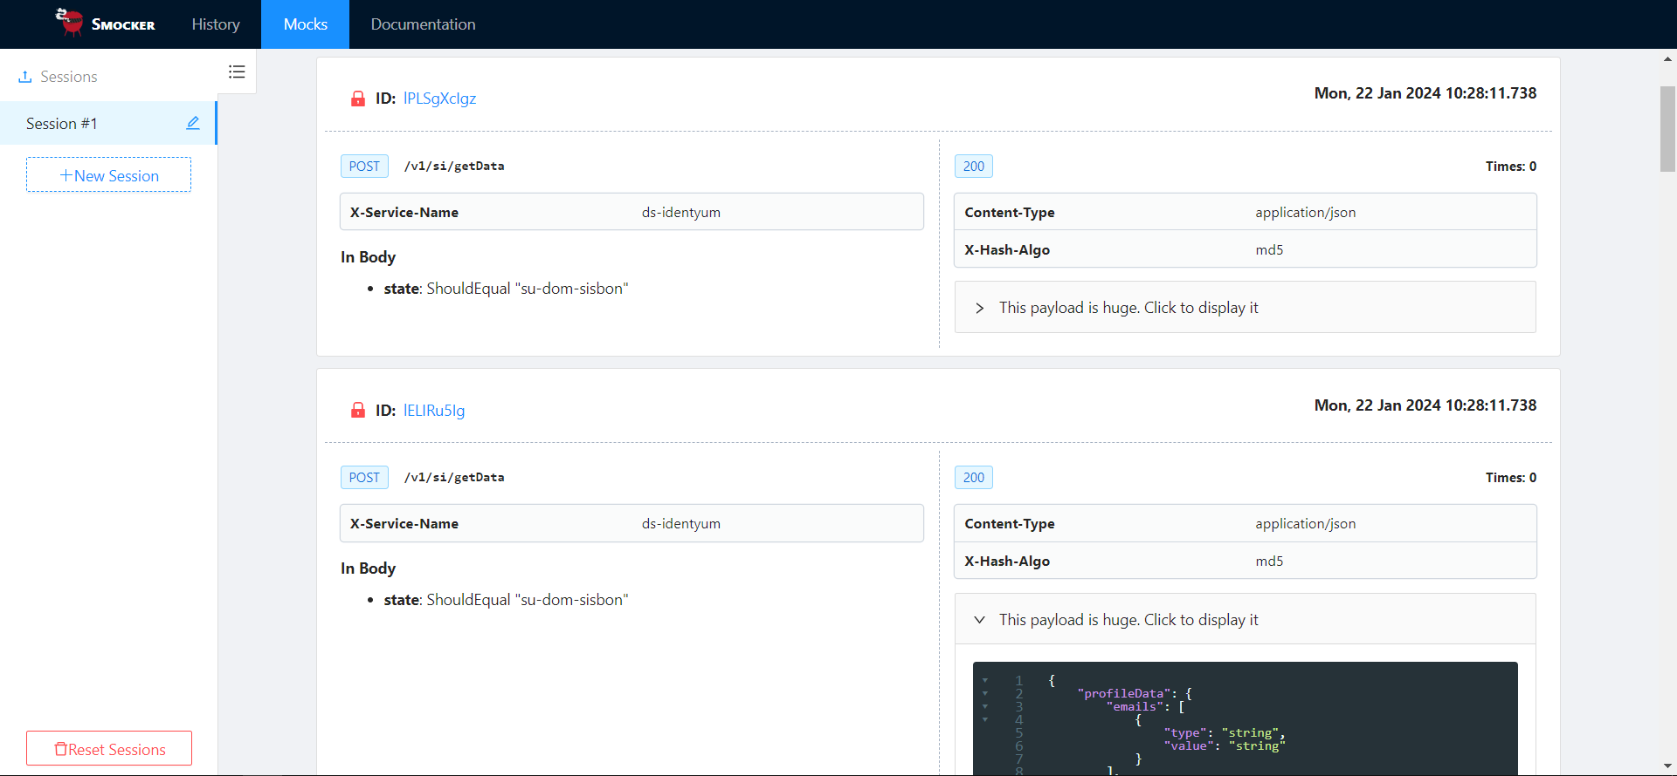

Slide 27

Preklady s

Slide 28
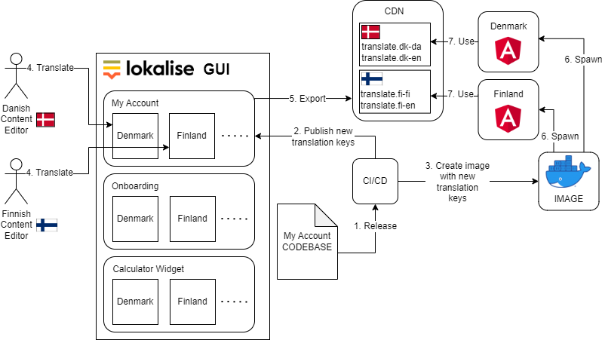
Angular SPA – translation management

Slide 29
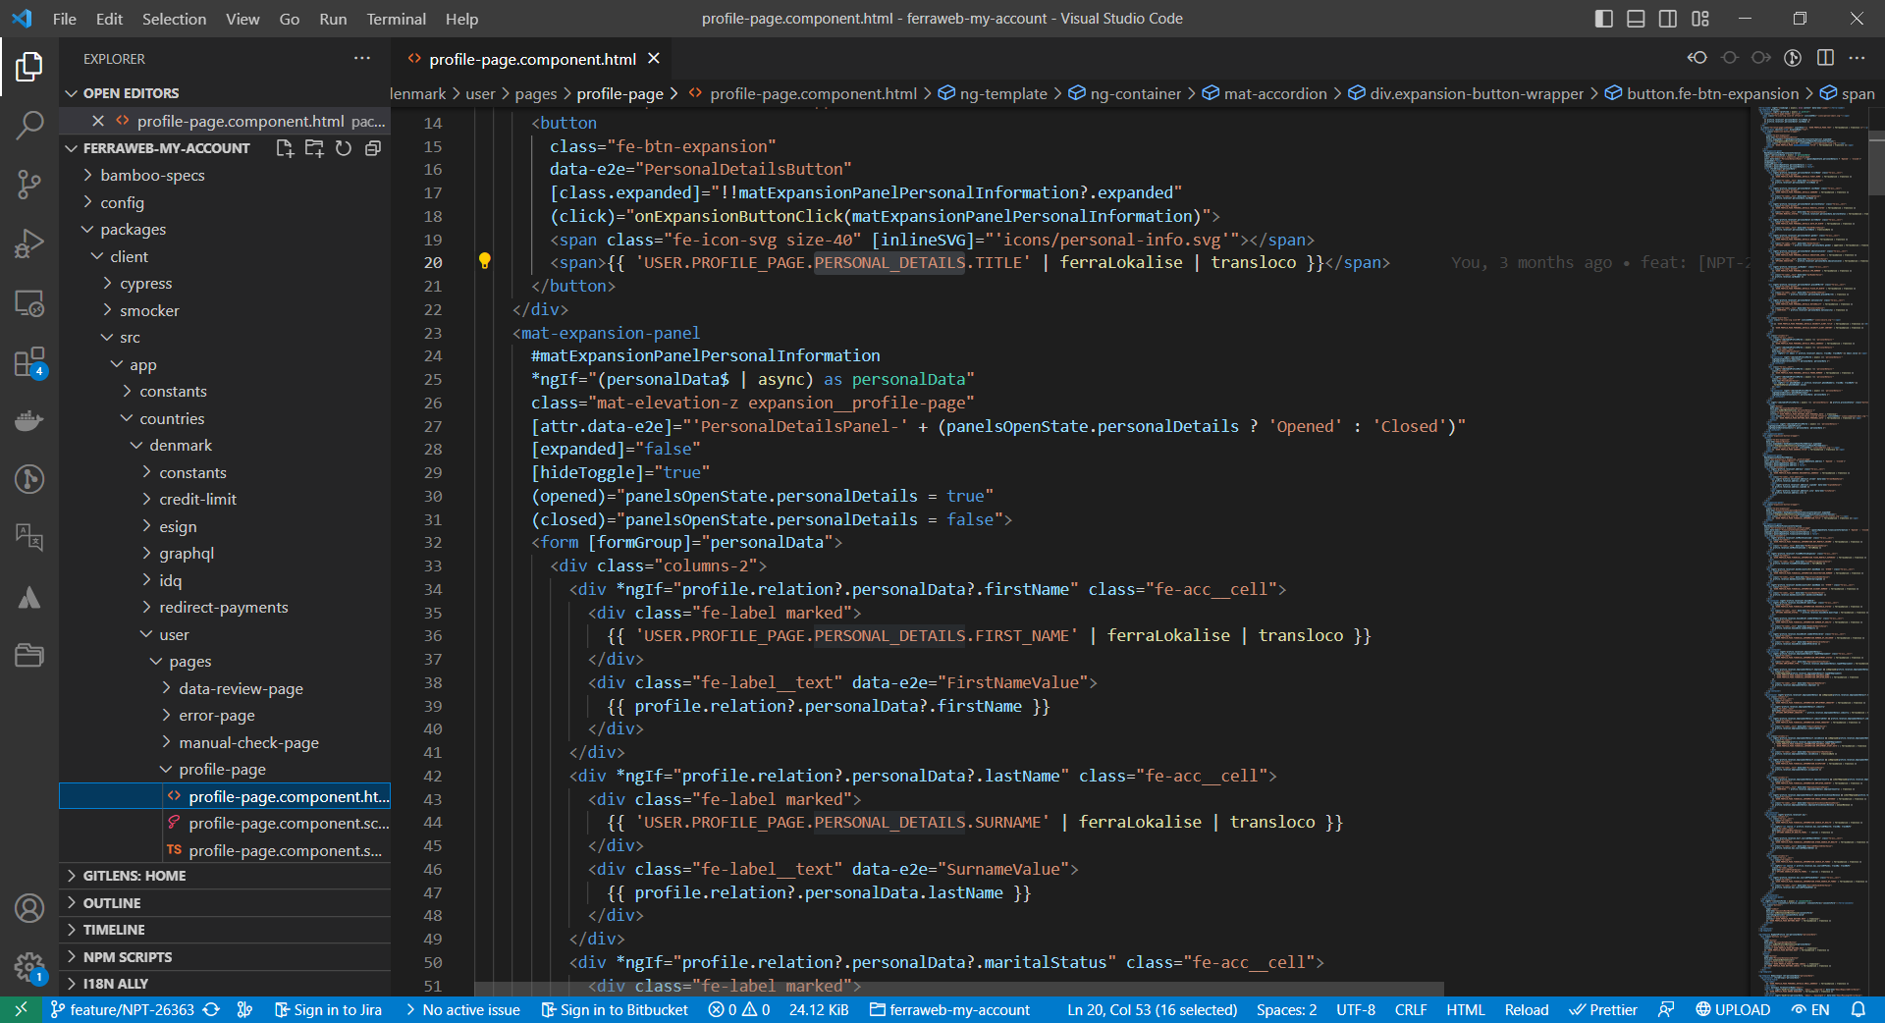

Slide 30
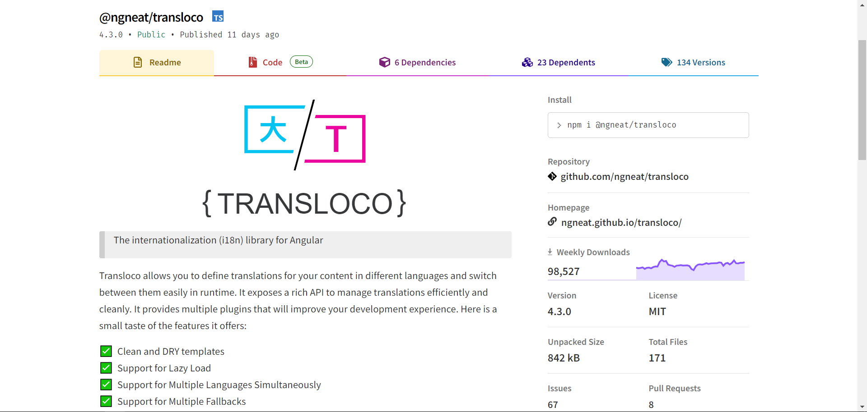

Slide 31
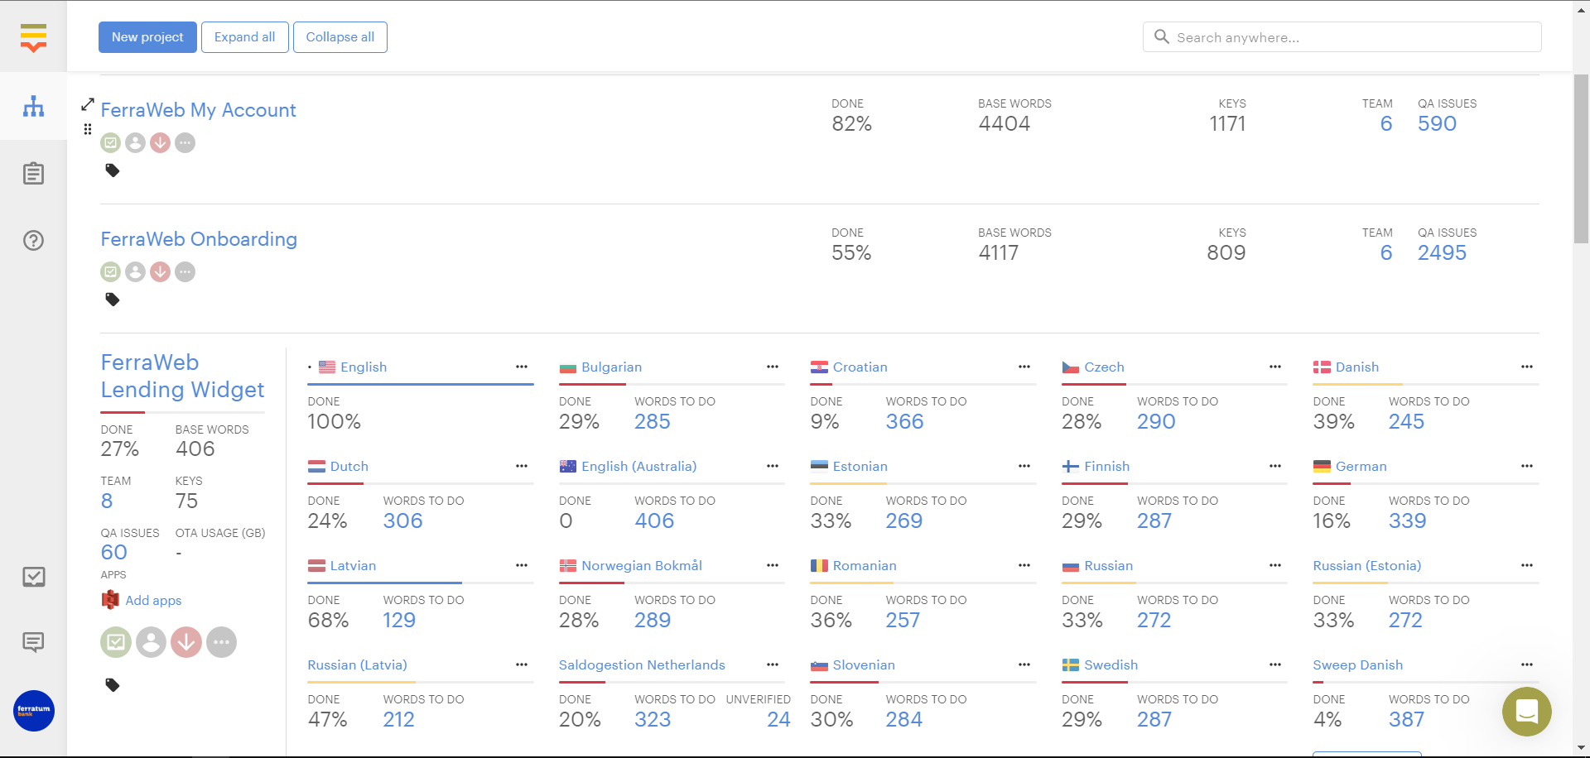

Slide 32
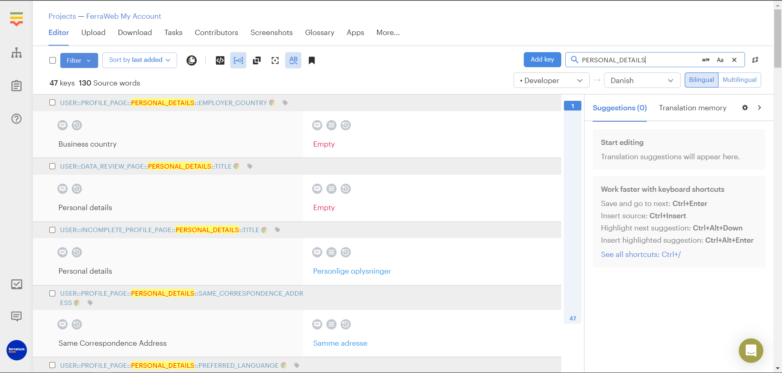

Slide 33
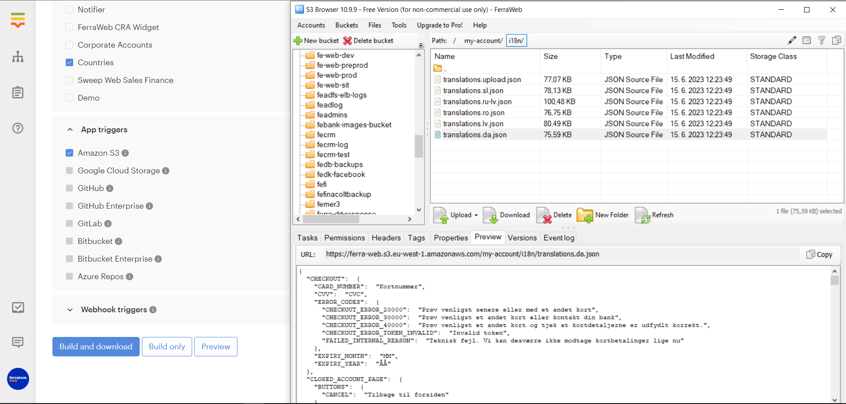

Slide 34
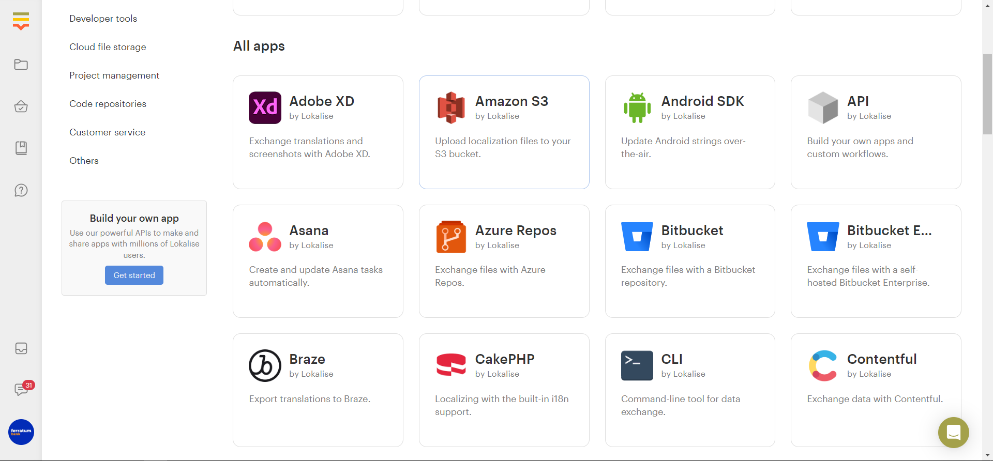

Slide 35
AUTHOR: Martin Šustek

